Slide 1
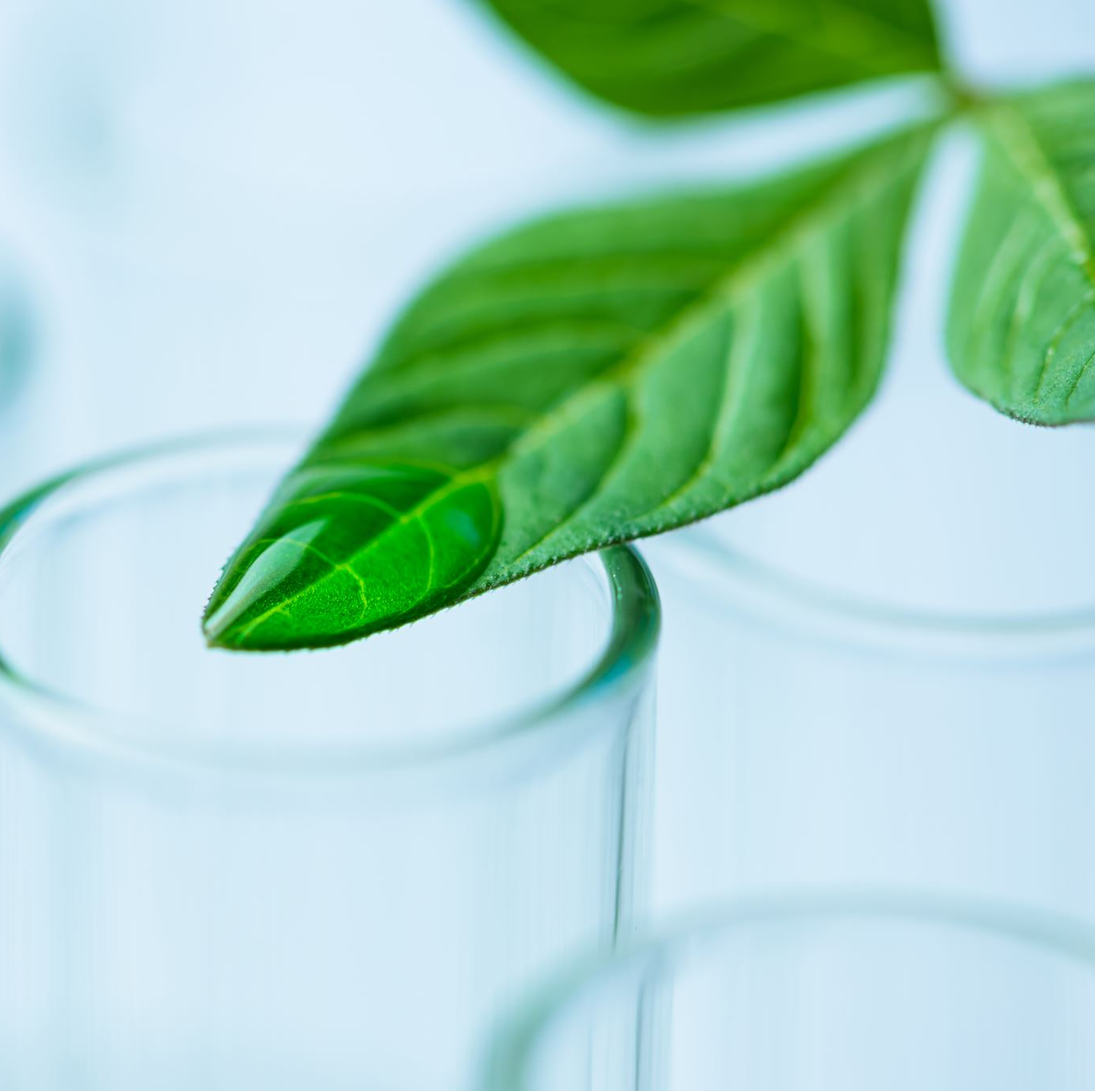
Plant Disease Detection
BY
Shivam Satav
Joel Randive
Omkar Sawant
Vipul Doiphode
Aditi Akadkar

Slide 2
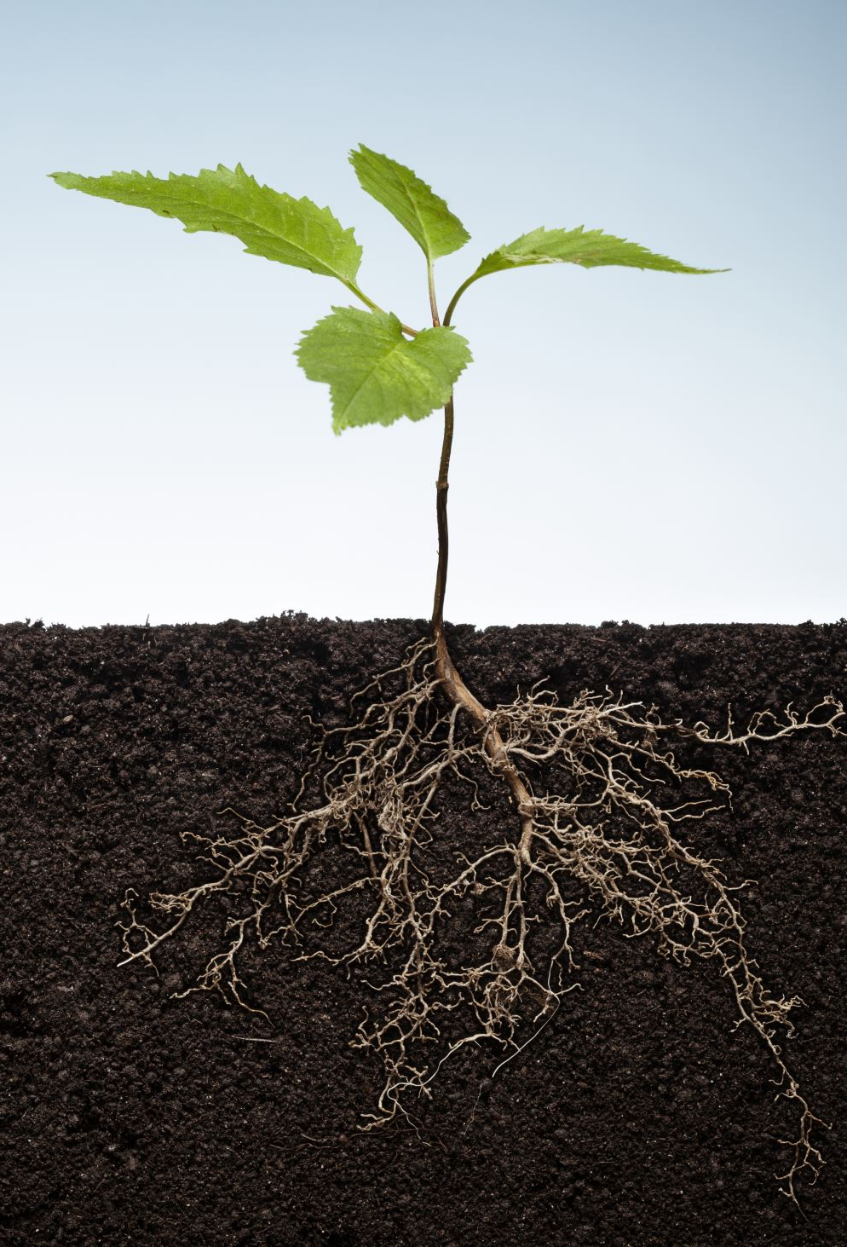
What is the importance of studying plant diseases?
The study of plant diseases is important as they cause loss to the plant as well as plant produce. The various types of losses occur in the field, in storage or any time between sowing and consumption of produce. The diseases are responsible for direct monitory loss and material loss.

Slide 3
About Project
Domain : Deep Learning
Problem Statement : To detect the leaves are infected or not
Technologies used : Python, CNN, Fast API, React, Keras, Tensorflow
Project Scope : It will help farmers to see their crops are infected or not so that vegetables will be healthy and fresh and it will prevent a loss to farmers
Proposed system: Using the CNN(Convolutional Neural Network) and using the DenseNet as the head in the Transfer Learning and using SVM as the classifier.Having 256 neurons in the hidden layer , and 15 neurons at the output layer for 15 image classes with a softmax activation function. Using Adam as an optimizer .

Slide 4
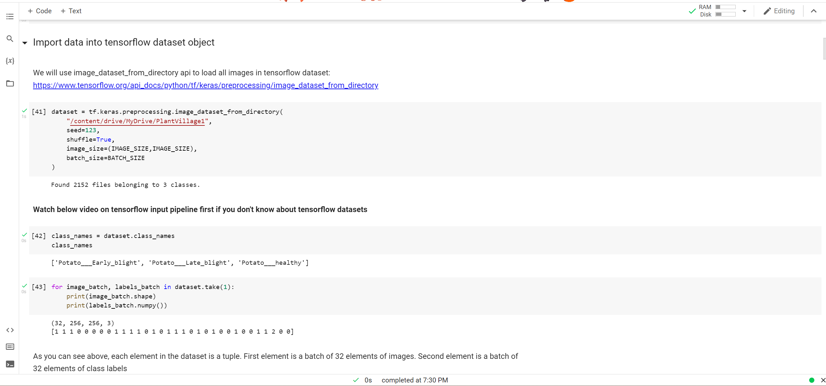
Importing Data into Tensorflow

Slide 5
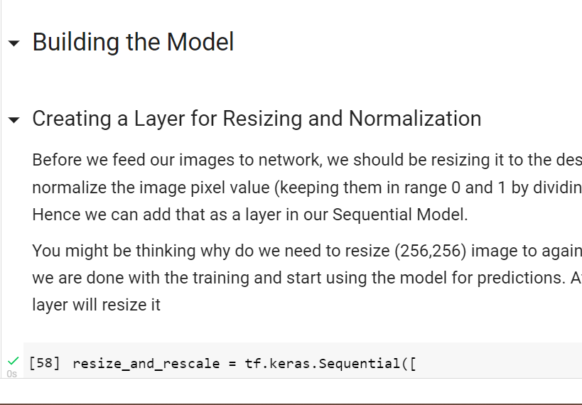
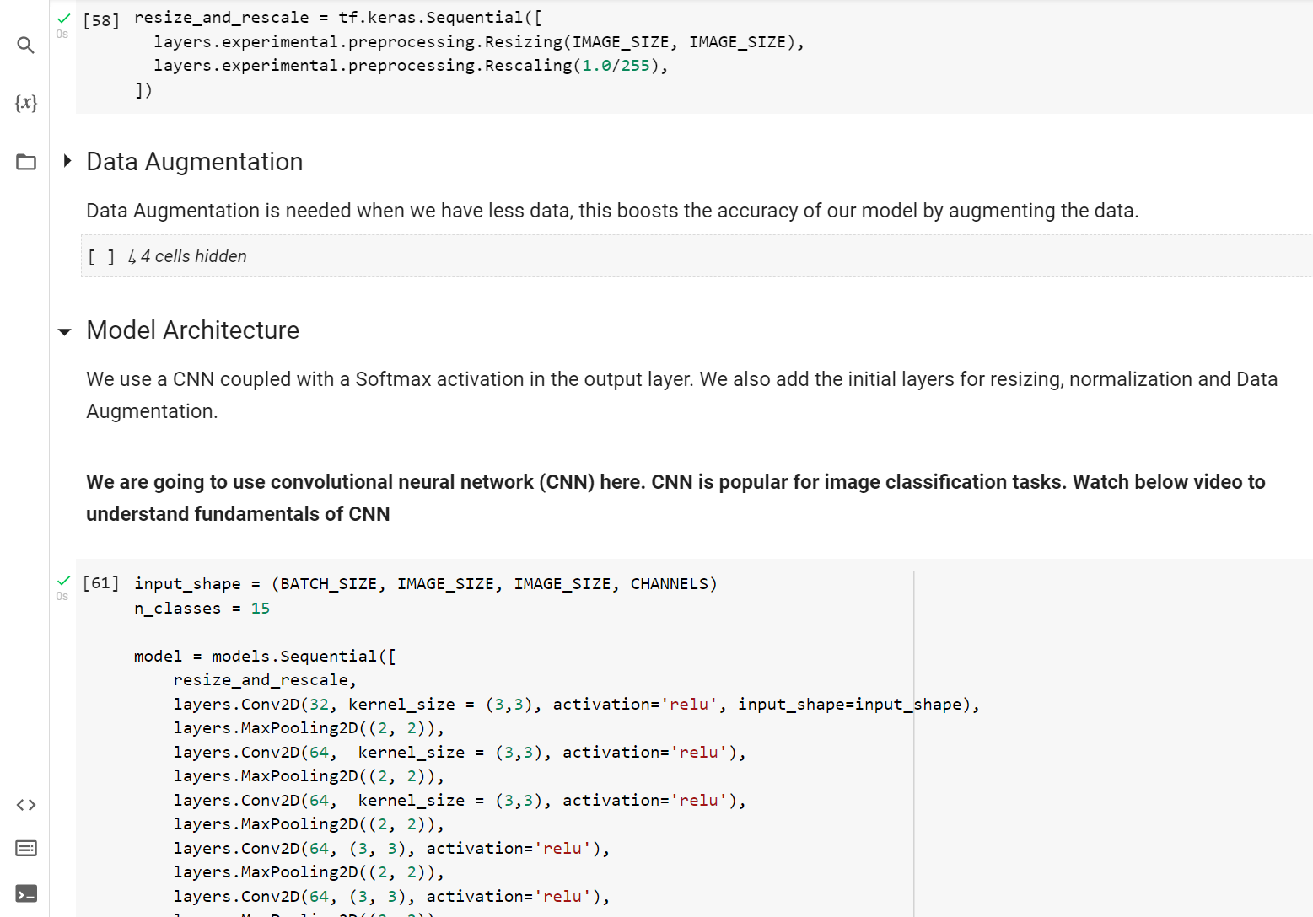
Building the Model

Slide 6
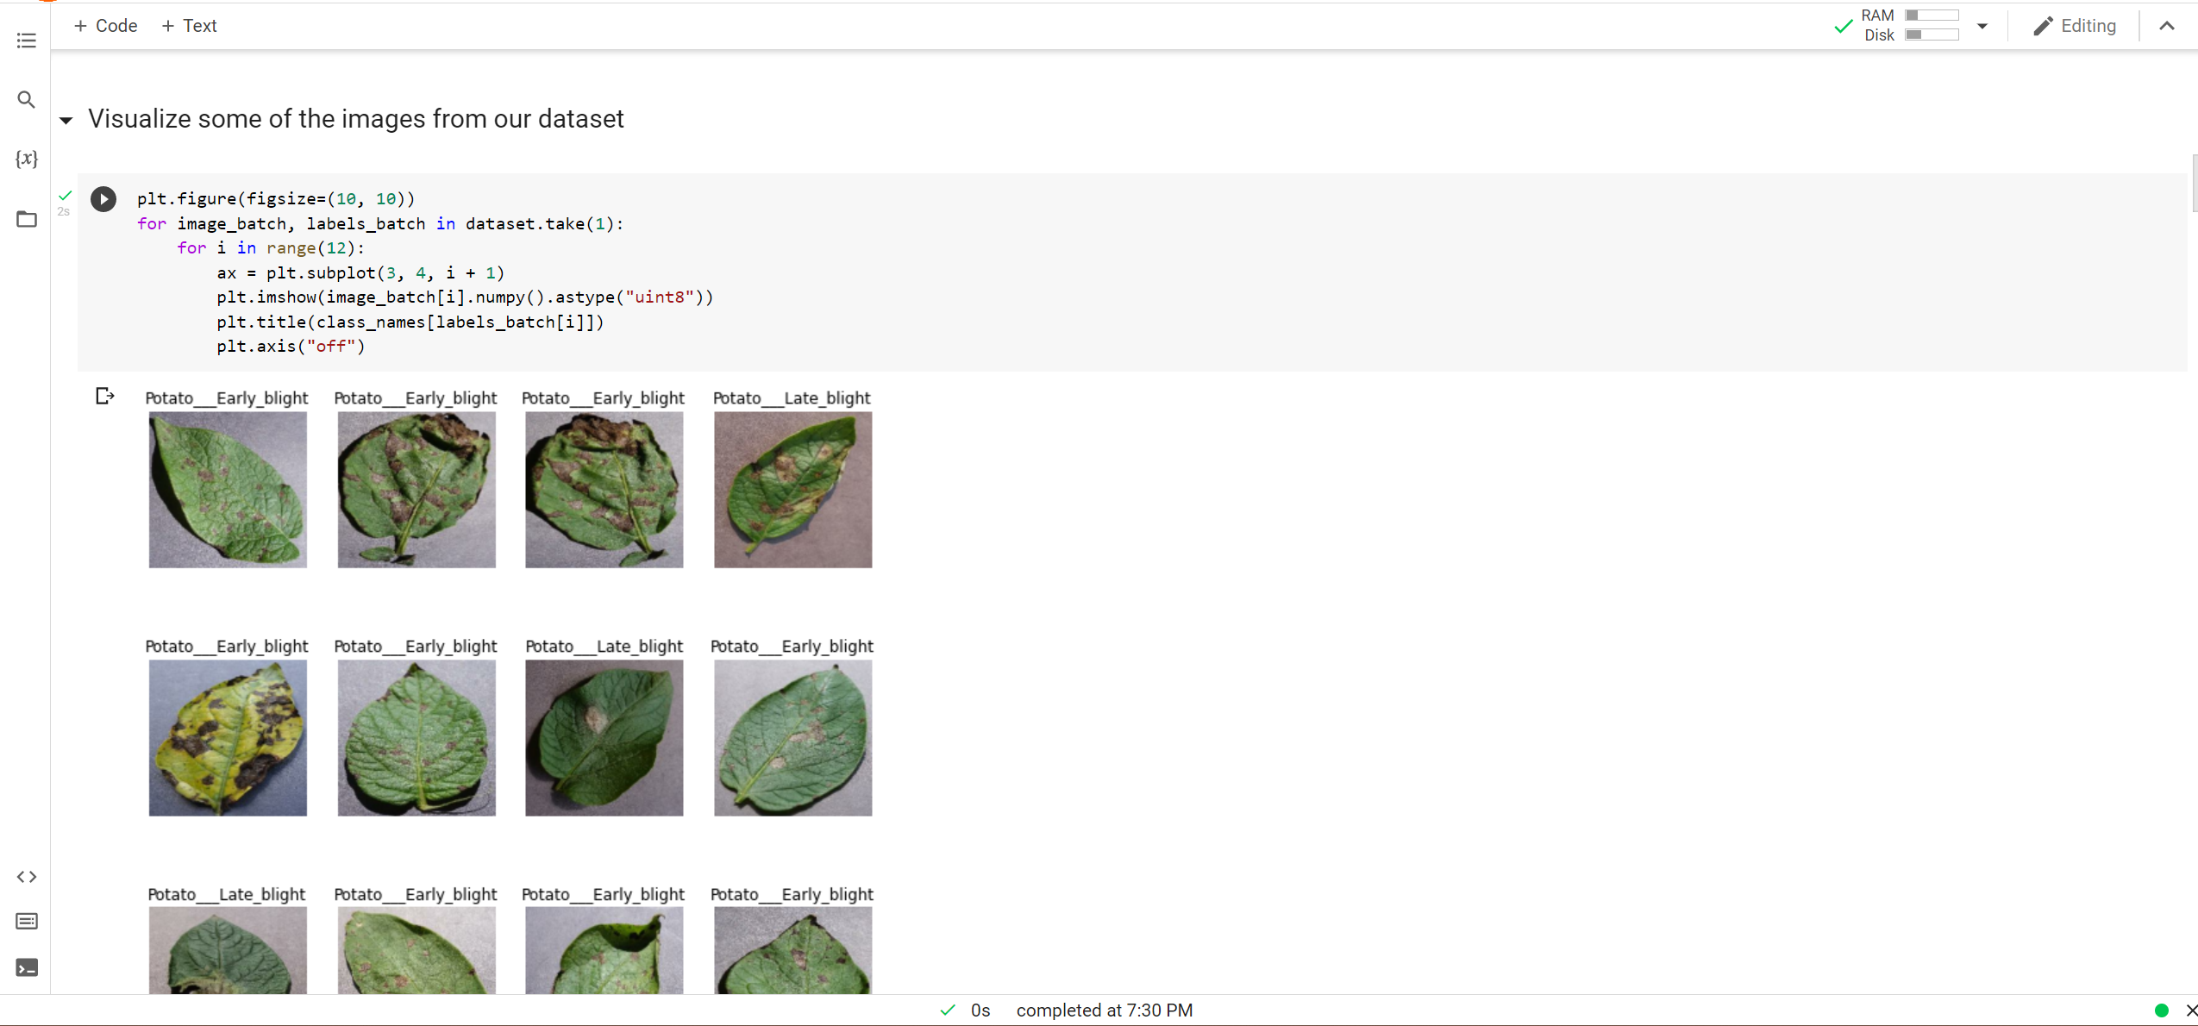
Data Visualize (Sample Image)

Slide 7
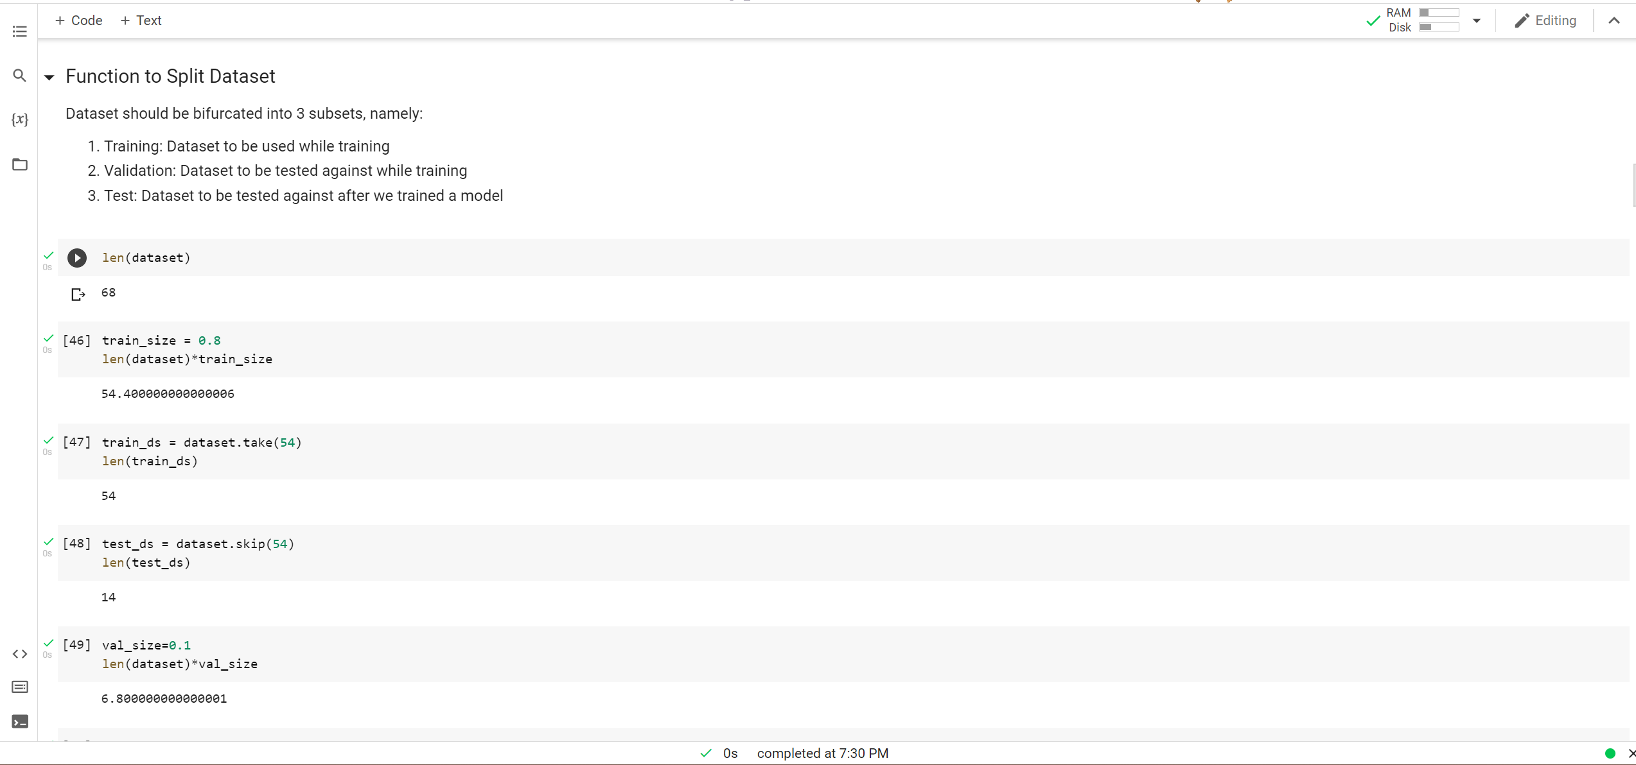
Spliting the dataset

Slide 8
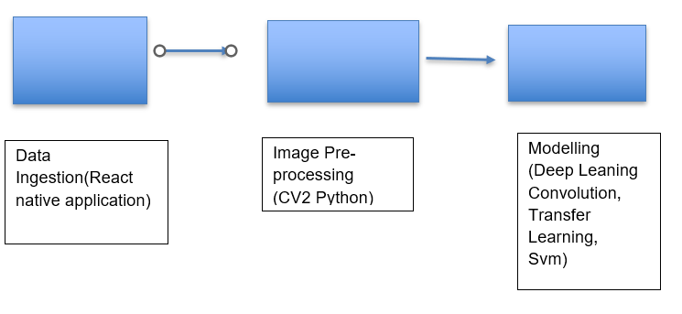
Model Architecture

Slide 9
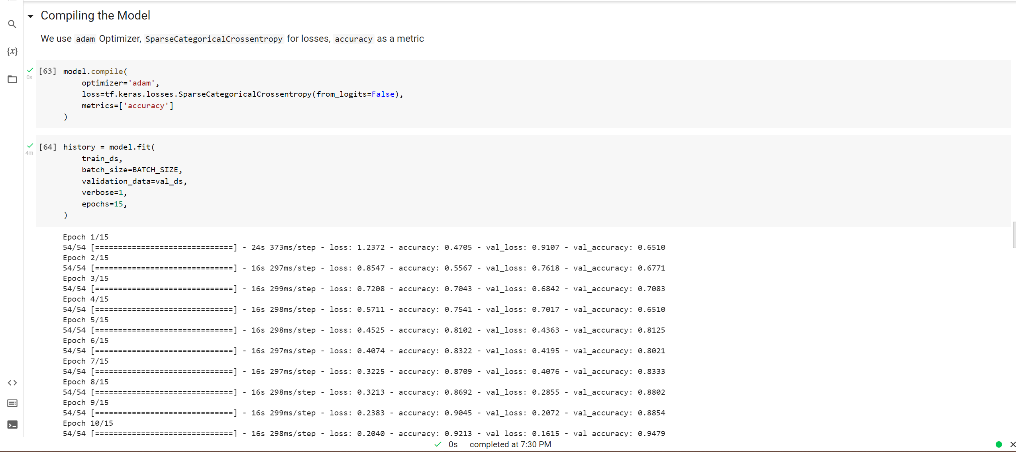
Compiling the model

Slide 10

Accuracy of model

Slide 11
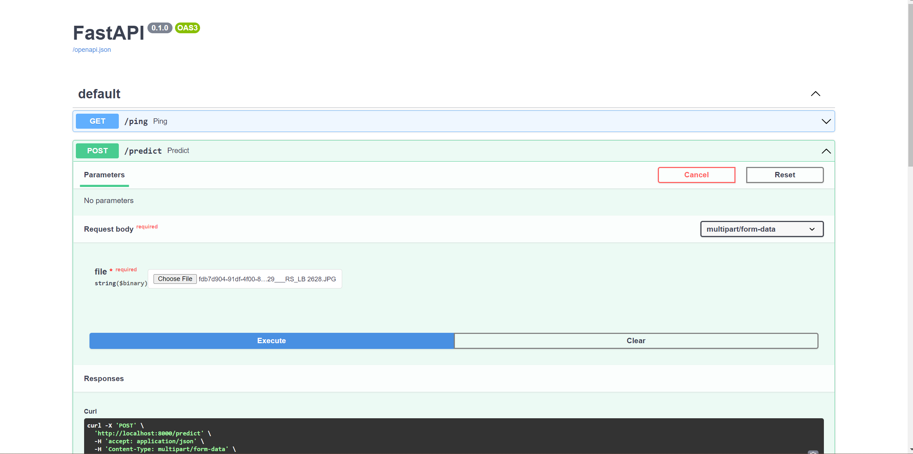
Fast API for hosting a website

Slide 12
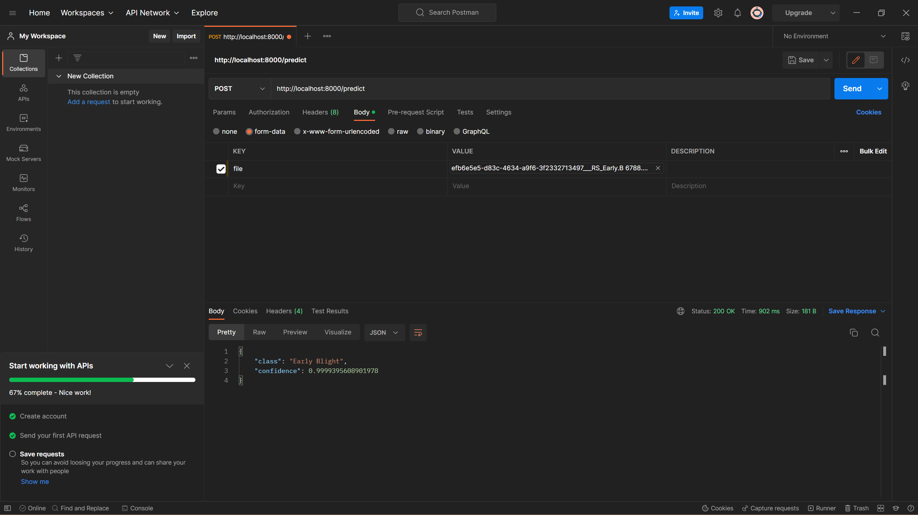
Adding key and value

Slide 13
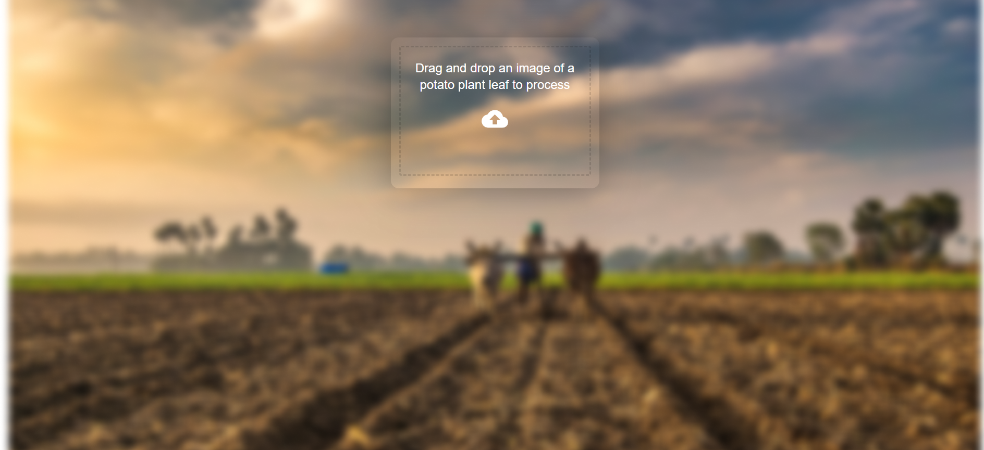
Website interface

Slide 14
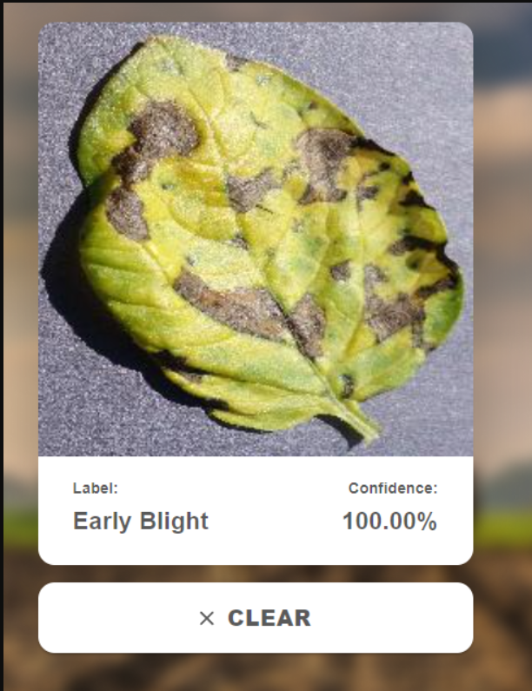
Ouput
As you can see we have taken a random leaf and our model have detected that it is Early blight and with confidence 100% and with accuracy of 96%

Slide 15
Literature Review
Data Set https://www.kaggle.com/arjuntejaswi/plant-village
https://www.frontiersin.org/articles/10.3389/fpls.2016.01419/full
https://www.researchgate.net/publication/314436486_An_Overview_of_the_Research_on_Plant_Leaves_Disease_detection_using_Image_Processing_Techniques
https://plantmethods.biomedcentral.com/articles/10.1186/s13007-021-00722-9

Slide 16
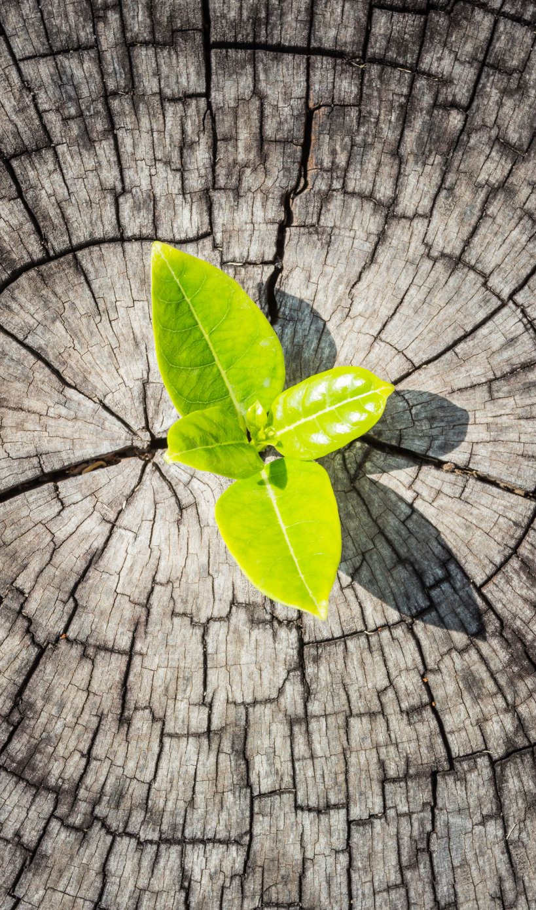
Thankyou

